Slide 1
Gartner Assignment Presentation

Slide 2
Project analysis slide 2
Data pre-processing
1- Merge data sets for all months Aug, Sep, Oct – this gives us bigger dataset to train
2- Inspect null rows and eliminate them
Data Pre-processing
3- Eliminate duplicate text records
4- Average number of words in a document comes out to be approx 4
5- There are 11k records with 1 word. 18k with 2 words - That’s a lot.
Total 74k records.
6- We don’t eleminate anything despite a single word in text field. Because 1 words are like devops, security, management which makes logical connection when considered as a whole corpus.

Slide 3
Project analysis slide 3
Task 1- Data Cleaning
CONVERT TEXT TO LOWER CASE
REMOVE PUNCTUATIONS, UNWANTED CHARACTERS, NUMBERS
REMOVE STOPWORDS
LEMMATIZATION
TOKENIZED DATA –FINAL DATA
Your model might treat a word which is in the beginning of a sentence with a capital letter different from the same word which appears later in the sentence but without any capital latter. This might lead to decline in the accuracy. Whereas I think, lowering the words would be a better trade off
Text may contain stop words like ‘the’, ‘is’, ‘are’. Stop words can be filtered from the text to be processed. There is no universal list of stop words in nlp research, however the nltk module contains a list of stop words.
Helps in returning the base or dictionary form of a word, which is known as the lemma
Example -
Lemma for studies is study
Lemma for studying is studying
Lemma for cries is cry
Lemma for cry is cry
"Tokens" are usually individual words (at least in languages like English) and "tokenization" is taking a text or set of text and breaking it up into its individual words. These tokens are then used as the input for other types of analysis or tasks, like parsing (automatically tagging the syntactic relationship between words).
Removing all the symbols , special characters, numbers which does not make any sense while reading through the data.

Slide 4
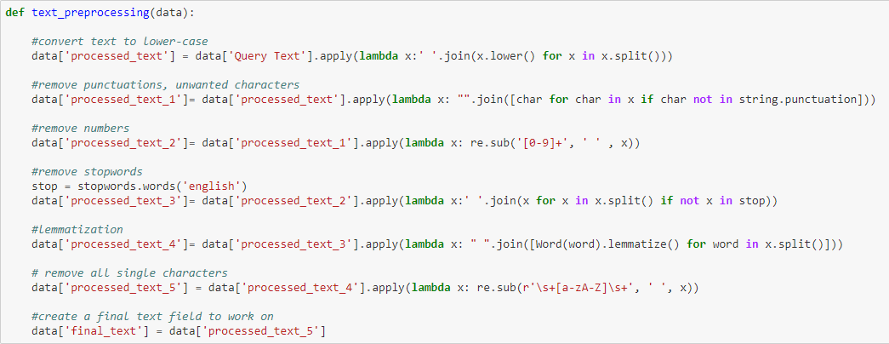
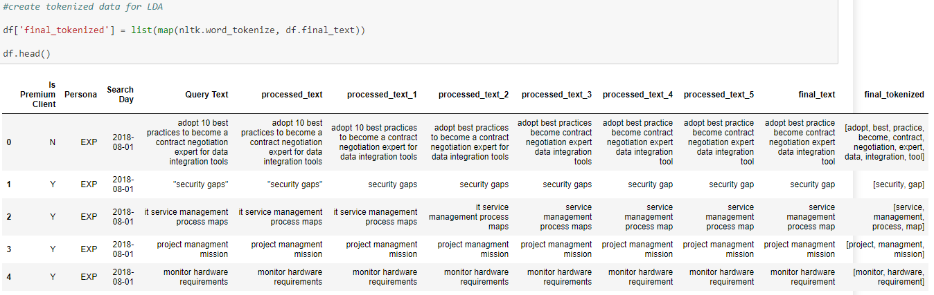
Project analysis slide 4
Task 1- Data Cleaning (Contd…) Snapshot of code and data

Slide 5
Project analysis slide 5
Task 1 – Topic Modelling
LDA – Latent Dirichlet Allocation
[(0,
'0.074*"management" + 0.037*"service" + 0.035*"business" + 0.032*"cloud" + '
'0.026*"toolkit" + 0.023*"model" + 0.016*"digital" + 0.015*"capability" + '
'0.015*"risk" + 0.010*"value"'),
(1,
'0.074*"g" + 0.021*"innovation" + 0.017*"report" + 0.015*"template" + '
'0.015*"china" + 0.014*"business" + 0.012*"learning" + 0.012*"summary" + '
'0.012*"web" + 0.011*"translation"'),
(2,
'0.043*"cio" + 0.037*"job" + 0.032*"description" + 0.031*"data" + '
'0.030*"key" + 0.029*"vendor" + 0.027*"metric" + 0.022*"intelligence" + '
'0.021*"role" + 0.020*"office"'),
(3,
'0.051*"market" + 0.047*"guide" + 0.046*"cycle" + 0.044*"hype" + '
'0.036*"technology" + 0.029*"infrastructure" + 0.025*"application" + '
'0.021*"automation" + 0.021*"service" + 0.020*"network"'),
(4,
'0.070*"strategy" + 0.039*"digital" + 0.038*"project" + 0.034*"customer" + '
'0.029*"use" + 0.026*"strategic" + 0.022*"trend" + 0.020*"ai" + '
'0.020*"business" + 0.020*"sap"'),
(5,
'0.074*"system" + 0.068*"tool" + 0.065*"analytics" + 0.043*"gartner" + '
'0.029*"microsoft" + 0.018*"api" + 0.014*"procurement" + 0.013*"core" + '
'0.013*"bank" + 0.010*"ibm"'),
(6,
'0.082*"enterprise" + 0.063*"platform" + 0.058*"architecture" + '
'0.055*"software" + 0.028*"practice" + 0.027*"best" + 0.027*"digital" + '
'0.020*"business" + 0.019*"plan" + 0.019*"planning"'),
(7,
'0.200*"magic" + 0.188*"quadrant" + 0.033*"erp" + 0.026*"process" + '
'0.021*"design" + 0.020*"crm" + 0.020*"cost" + 0.018*"management" + '
'0.011*"software" + 0.011*"retail"'),
(8,
'0.153*"data" + 0.112*"security" + 0.046*"information" + 0.042*"governance" '
'+ 0.041*"transformation" + 0.034*"center" + 0.026*"management" + '
'0.024*"policy" + 0.022*"digital" + 0.014*"effective"'),
(9,
'0.050*"agile" + 0.038*"development" + 0.038*"team" + 0.027*"support" + '
'0.025*"service" + 0.021*"ea" + 0.018*"desk" + 0.014*"resource" + '
'0.010*"database" + 0.009*"help"')]
These are the top 10 topics with the weightage assigned to each word occurence
1- Using gensim python library for creating bag of words and creating corpus to feed into LDA. The final tokenized text is used from Data cleaning
2- Using LDAMulticore to find the topics that are most talked about searched for.
Multicore runs the code on multiple cores of CPU, faster than nomal LDA
3- Topics Assumed = 10
Training time = 4mins 40secs

Slide 6
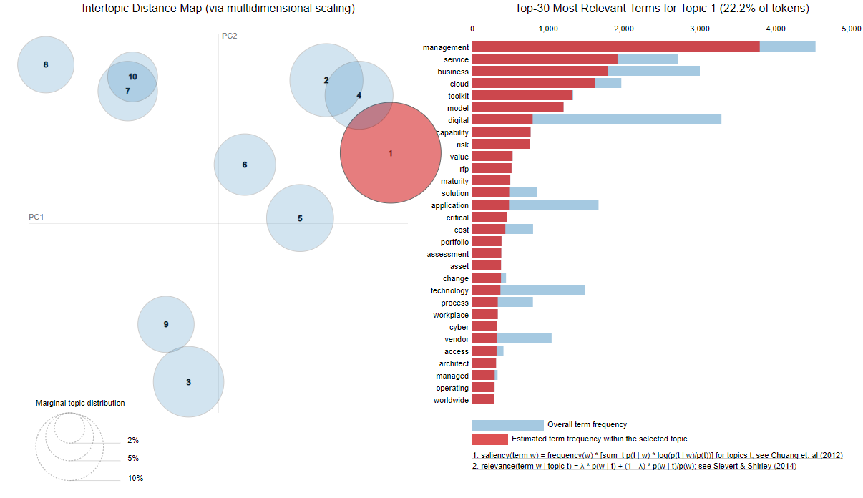
Project analysis slide 6
Task 1 – Topic Modelling(Contd…)
This can be better visualized inside a jupyter notebook which uses pyLDAvis i.e. Python library for interactive topic model visualization. Navigate to Top 10 topics by frequency of occurrence in the attached notebook -

Slide 7
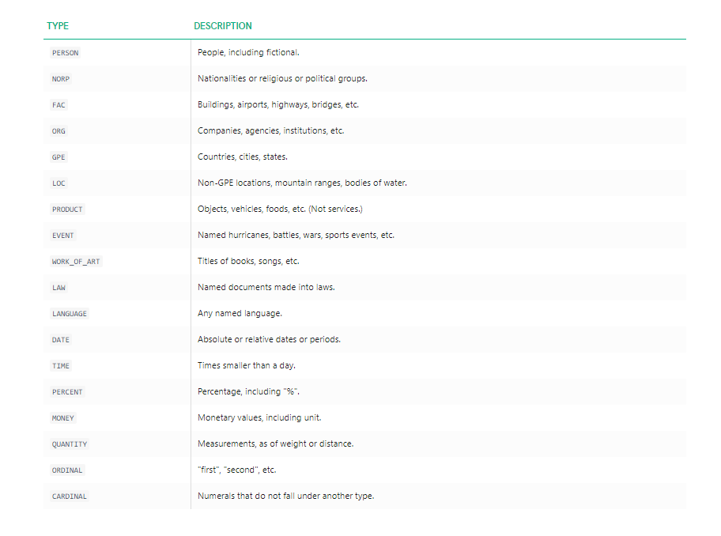
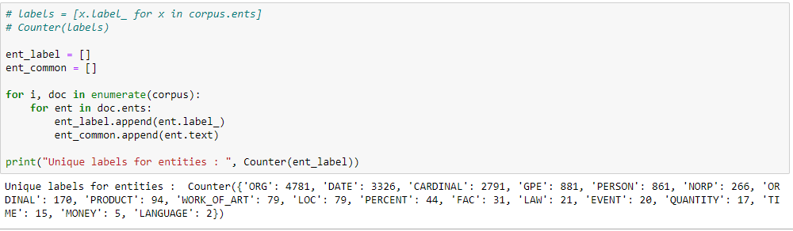
Project analysis slide 7
Task 2 -Named Entity Recognition
Models trained on the
Spacy NER tagger – Doesn’t understand lowercase
StandfordNERTagger – Best result,slowest
CoreNLP tagger – Fastest, bad result
The data is not good quality to train. Example – names in lowercase characters are mentioned in dataset which are not being recognized as an entity.
We went with Spacy NER tagger for fastest resuts and never converted our data to lowercase
Below are the unique label entities that are found in corpus.

Slide 8
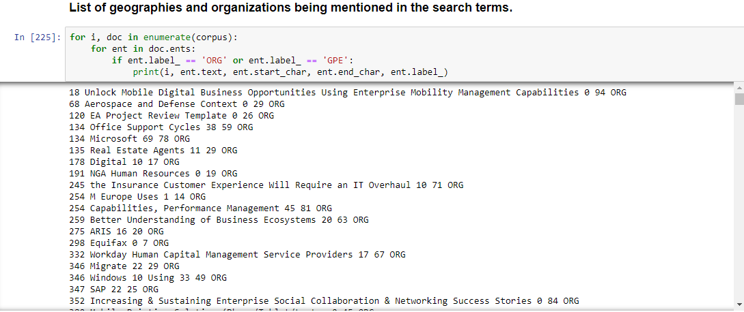
Project analysis slide 7
Task 2 -Named Entity Recognition(Contd…)
Some of the most popular entities
China
India
B2b
Digital Business
Gartner
SAP
Microsoft
DevOps
CIO
List of Geographies and Organisations – Scroll down thru code to check more -

Slide 9
Thank You

